Slide 1
Customer Data
Analysis

Slide 2
Task - 1
The shopping distribution according to gender.
Gender | Total Revenue | Total Quantity | Average Revenue | No. Of Transaction
Female | 150207136 | 178659 | 2525.253623 | 59482
Male | 101298658.2 | 120053 | 2534.050237 | 39975
Grand Total | 251505794.2 | 298712 | 2528.789268 | 99457
Female customers contributed approximately 48% more revenue than male customers.
They made about 49% more transactions compared to males.
The average revenue per transaction is almost identical between genders, indicating similar purchasing power per visit.

Slide 3
Task – 2
Which gender did we sell more products to.
Gender | Product Quantity
Female | 178659
Male | 120053
Grand Total | 298712
Female customers contributed approximately 48% more revenue than male customers.
They made about 49% more transactions compared to males.
The average revenue per transaction is almost identical between genders, indicating similar purchasing power per visit.

Slide 4
Task – 3
Which gender generated more revenue.
Gender | Revenue
Female | 150207136
Male | 101298658.2
Grand Total | 251505794.2
Explanations:-
Female customers generated more revenue. (150 million)

Slide 5
Task – 4
Distribution of purchase categories relative to other columns.
1. Category vs Gender Wise Products Quantity
Category | Female | Male
Clothing | 62039 | 41519
Cosmetics | 27261 | 18204
Food & Beverage | 26362 | 17915
Toys | 18362 | 11959
Shoes | 17906 | 12311
Technology | 8977 | 6044
Souvenir | 8976 | 5895
Books | 8776 | 6206
Grand Total | 178659 | 120053

Slide 6
Task – 4
Distribution of purchase categories relative to other columns.
2. Category vs Gender Wise Products Quantity.
Category | Revenue
Clothing | 113996791
Shoes | 66553451.47
Technology | 57862350
Cosmetics | 6792862.9
Toys | 3980426.24
Food & Beverage | 849535.05
Books | 834552.9
Souvenir | 635824.65
Grand Total | 251505794.2

Slide 7
Task – 4
Distribution of purchase categories relative to other columns.
3. Age Group And Category Wise Quantity Sold.

Slide 8
Task – 5
Shopping distribution according to age.
1. Age Group Wise Quantity Sold.
Age Group | Quantity
18-30 | 75172
31-40 | 57850
41-50 | 57156
51-60 | 56997
61-70 | 51537
Grand Total | 298712

Slide 9
Task – 5
Shopping distribution according to age.
2. Age Group Wise Revenue Generated.
Age Group | Revenue
18-30 | 63047402.11
31-40 | 48370413.32
41-50 | 48779846.58
51-60 | 47788662.58
61-70 | 43519469.66
Grand Total | 251505794.2

Slide 10
Task – 5
Shopping distribution according to age.
3. Age Group Related To The Quantity Sold By The Category.
Category | 18-30 | 31-40 | 41-50 | 51-60 | 61-70
Clothing | 26094 | 19694 | 20083 | 19849 | 17838
Cosmetics | 11203 | 8987 | 8579 | 8829 | 7867
Food & Beverage | 11051 | 8864 | 8354 | 8441 | 7567
Toys | 7853 | 5682 | 5791 | 5632 | 5363
Shoes | 7684 | 5771 | 5863 | 5665 | 5234
Books | 3839 | 2881 | 2819 | 2862 | 2581
Souvenir | 3767 | 2954 | 2754 | 2902 | 2494
Technology | 3681 | 3017 | 2913 | 2817 | 2593
Grand Total | 75172 | 57850 | 57156 | 56997 | 51537

Slide 11
Task – 6
Which age categories did we sell more products to.
Age Group | Quantity
18-30 | 75172
31-40 | 57850
41-50 | 57156
51-60 | 56997
61-70 | 51537
Grand Total | 298712
we sell more products to
18-30 age category

Slide 12
Task – 7
Which age categories generated more revenue.
Age Group | Revenue
18-30 | 63047402.11
31-40 | 48370413.32
41-50 | 48779846.58
51-60 | 47788662.58
61-70 | 43519469.66
Grand Total | 251505794.2
18 t0 30 age category generated more revenue other than .

Slide 13
Task – 8
Distribution of purchase categories relative to other columns.
Shopping Mall | 18-30 | 31-40 | 41-50 | 51-60 | 61-70
Mall of Istanbul | 15012 | 11543 | 11667 | 11405 | 10487
Kanyon | 14923 | 11391 | 11599 | 11517 | 10027
Metrocity | 11204 | 8549 | 8590 | 8698 | 7853
Metropol AVM | 7895 | 6056 | 5676 | 5699 | 5204
Istinye Park | 7454 | 5639 | 5647 | 5564 | 5161
Cevahir AVM | 3867 | 2987 | 2880 | 2777 | 2438
Forum Istanbul | 3784 | 2820 | 2770 | 2773 | 2705
Zorlu Center | 3767 | 2979 | 2906 | 2970 | 2612
Viaport Outlet | 3727 | 2921 | 2683 | 2804 | 2581
Emaar Square Mall | 3539 | 2965 | 2738 | 2790 | 2469
Grand Total | 75172 | 57850 | 57156 | 56997 | 51537

Slide 14
Task – 9
Does the payment method have a relation with other columns.
1. Age Group Wise Total Transaction.
Age Category | Cash | Credit Card | Debit Card | Grand Total
18-30 | 11177 | 8785 | 5062 | 25024
31-40 | 8618 | 6771 | 3877 | 19266
41-50 | 8464 | 6700 | 3902 | 19066
51-60 | 8423 | 6630 | 3879 | 18932
61-70 | 7765 | 6045 | 3359 | 17169
Grand Total | 44447 | 34931 | 20079 | 99457

Slide 15
Task – 9
Does the payment method have a relation with other columns.
2. Payment Method Related To Category And Revenue.
Category | Cash | Credit Card | Debit Card
Clothing | 51308878.72 | 39351590.96 | 23336321.36
Shoes | 29782836.08 | 23560873.69 | 13209741.7
Technology | 25937100 | 20493900 | 11431350
Cosmetics | 2962690.9 | 2454603.54 | 1375568.46
Toys | 1810600.96 | 1403494.4 | 766330.88
Books | 379946.85 | 280608.3 | 173997.75
Food & Beverage | 375707.51 | 302942.52 | 170885.02
Souvenir | 274482 | 229110.36 | 132232.29
Grand Total | 112832243 | 88077123.77 | 50596427.46

Slide 16
Task – 10
How is the distribution of the payment method.
Payment Method | Total Quantity | Total Revenue | Transactio Count
Cash | 133370 | 112832243 | 44447
Credit Card | 105045 | 88077123.77 | 34931
Debit Card | 60297 | 50596427.46 | 20079
Grand Total | 298712 | 251505794.2 | 99457
Insights:
Cash is the most used payment method in terms of quantity sold, revenue, and transactions.
Credit Card ranks second, showing strong usage for higher-value purchases.
Debit Card has the lowest usage in all three metrics.

Slide 17
Visualize The Data Using
POWER BI

Slide 18
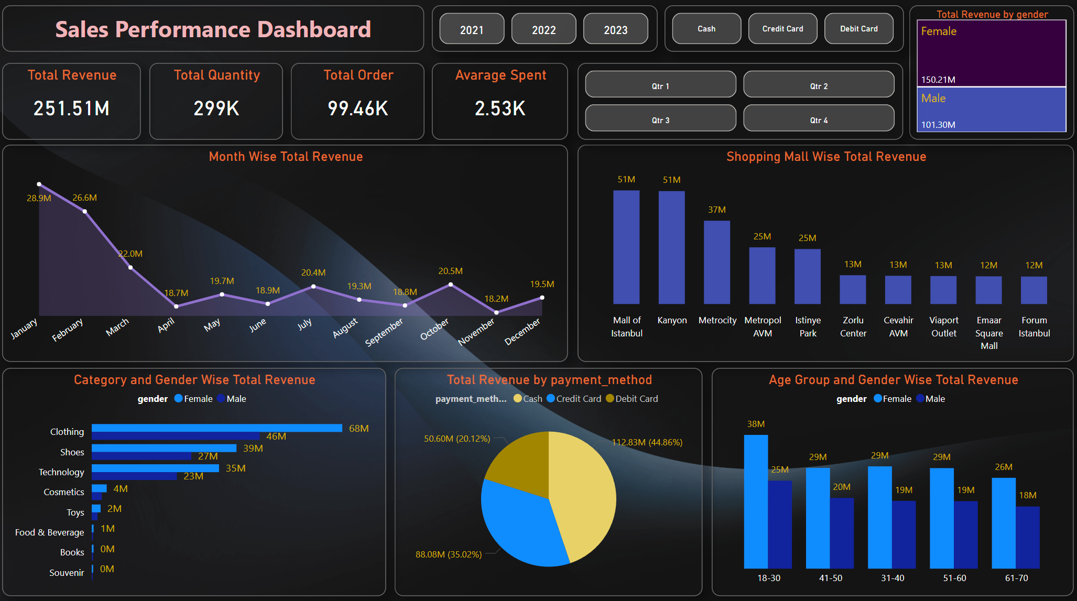

Slide 19
Sales Performance Dashboard Insights
Comprehensive Analysis Based on Dashboard Visuals

Slide 20
Key Performance Indicators (KPIs)
• Total Revenue: $251.51M
• Average Spent per Order: $2.53K
• Total Quantity Sold: 299K
• Total Orders: 99.46K

Slide 21
Revenue by Gender:
Female Customers: 150.21M (60%)
Male Customers: 101.30M (40%)
Insight:
Females are the dominant revenue drivers

Slide 22
Month-wise Total Revenue:
Peak in January (28.9M) and February (26.6M), then a gradual decline.
Observation: Revenue significantly drops after Q1. Potential seasonal or promotional effect.

Slide 23
Mall-wise Revenue:
Top performers: Mall of Istanbul and Kenyon (51M each).
Insight: Focused marketing or traffic could be key contributors.

Slide 24
Category and Gender-wise Revenue:
Clothing leads with 114M combined (68M Female, 46M Male).
Shoes and Technology are the next high-revenue categories.

Slide 25
Age Group Revenue:
18–30 is the most profitable segment: 63M (38M Female, 25M Male).
Insight: Young adults are the most active spenders.

Slide 26
Payment Method Revenue:
Dominated by Cash 112.83M (44.86%), then Credit Cards 88.08M (35.02%) and Debit Card 50.60M (20.12%)

Slide 27
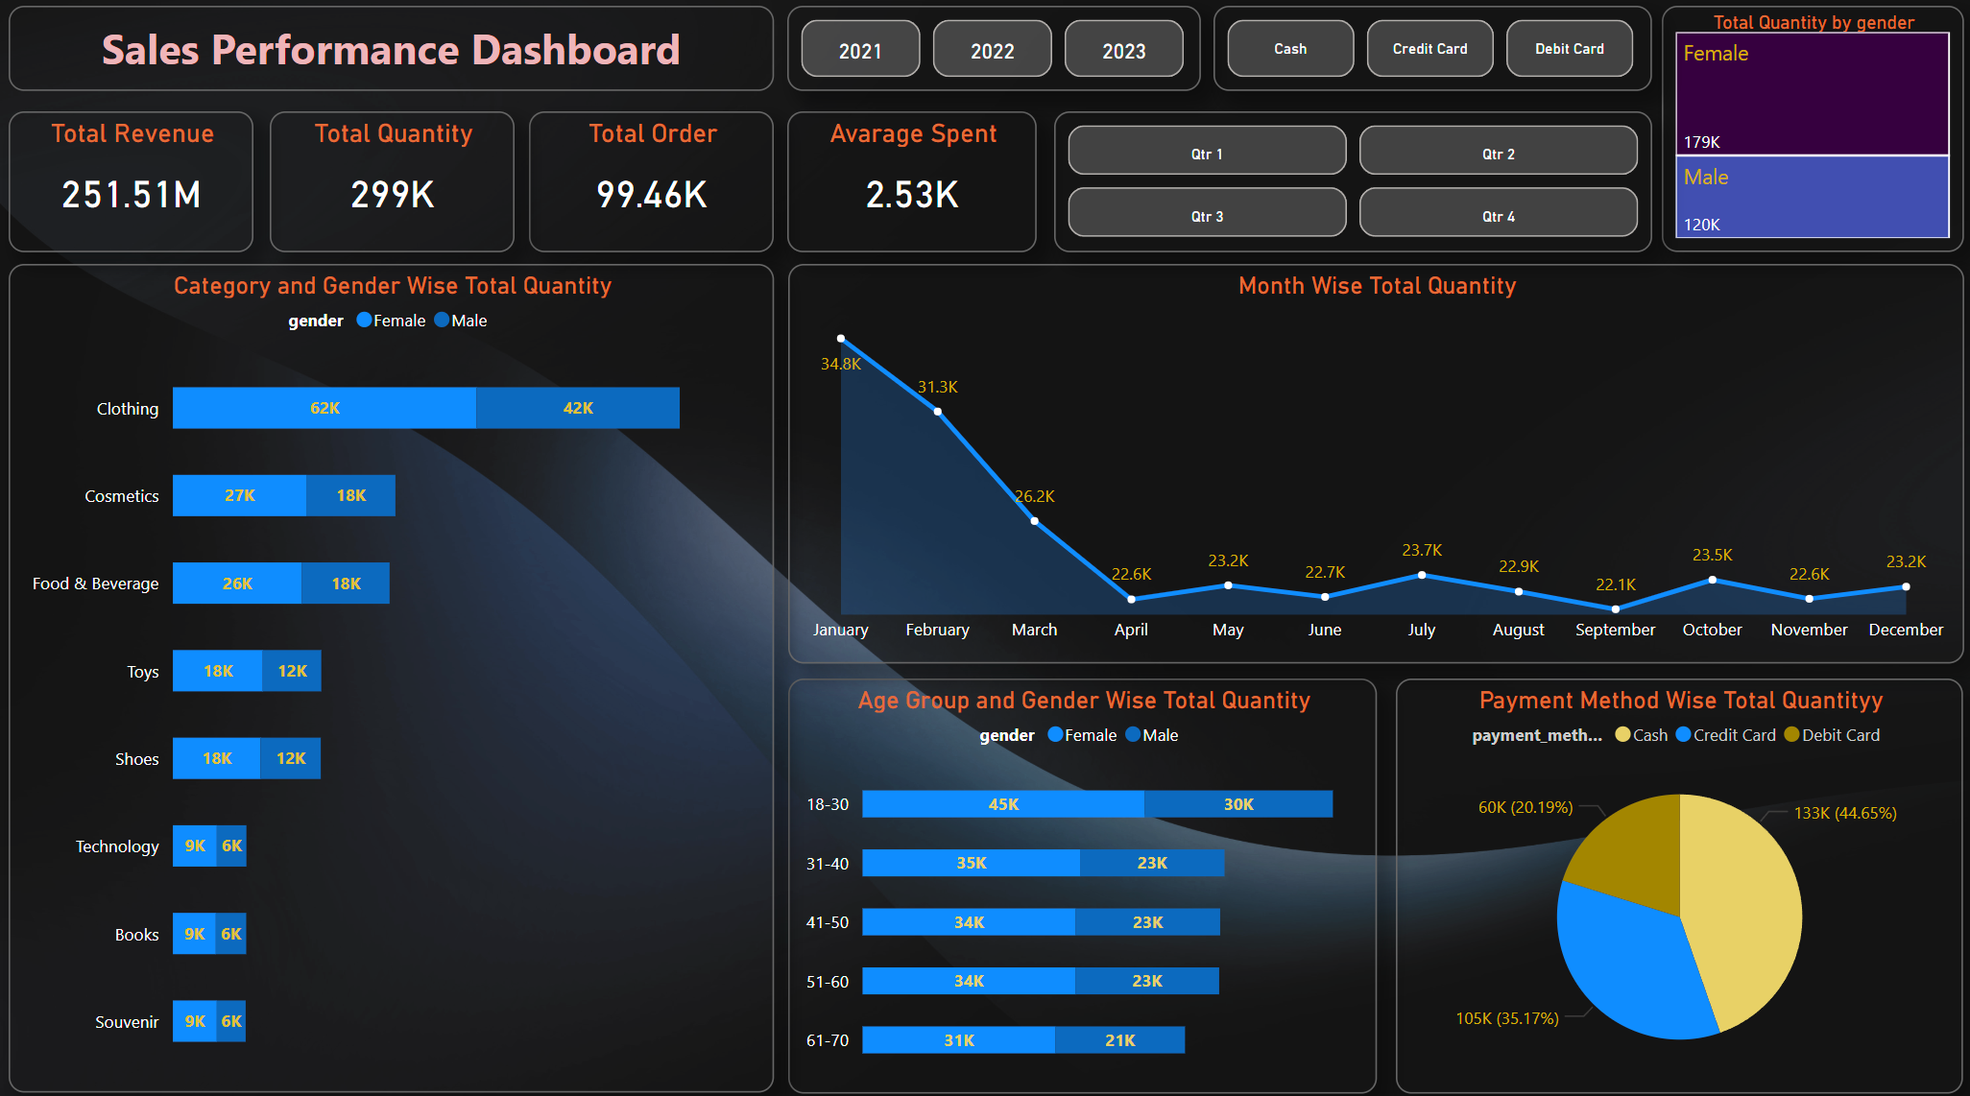

Slide 28
Quantity by Gender:
Female Customers: 179K (60%)
Male Customers: 120K (40%)
Insight:
Female customers purchase more and spend more.

Slide 29
Month-wise Quantity:
Peak in January (34.8K), February (31.3K). Clear seasonality.
Lowest in Q2 and slight recovery in Q4.

Slide 30
Category and Gender-wise Quantity:
Clothing, Cosmetics, and Food & Beverage dominate quantity sold.
Clothing: 62K Female vs. 42K Male
Cosmetics:27K Female vs 18K Male
Food & Beverage: 26K Female vs 18K Male. consistent with revenue data.

Slide 31
Age Group Quantity:
18–30 age group again dominates — aligns with revenue stats.
All age brackets show higher female participation.

Slide 32
Payment Method Quantity:
Cash 133K (44.65%) most used, then Credit Card 105K (35.17%), and Debit Card 60K (20.19%) same as revenue distribution.

Slide 33
Business Recommendations
1. Targeted Marketing
Focus campaigns on Female Customers (18–30 years) — clearly the top spenders and buyers.
Promote Clothing & Shoes more heavily across malls and online platforms.
2. Seasonal Promotions
Revenue/quantity is strong in Q1 — plan seasonal discounts, end-of-year sales, or loyalty programs for Q2-Q4 to stabilize off-peak sales.
3. Mall Performance Optimization
Study what drives success in Mall of Istanbul and Kenyon — replicate strategies in low-performing locations (e.g., Forum Istanbul, Emaar).

Slide 34
4. Payment Strategy
Since most users prefer Cash/Credit cards, offer card-based cashback, EMI options, and exclusive bank tie-ups.
5. Category Expansion
Technology, Books, Souvenir show lower sales volume — explore bundling offers or influencer marketing to boost visibility.
6. Customer Experience
Consider personalized offers for loyal female buyers and targeted re-engagement for males.

Slide 35
Thank You

